Slide 1

Tracing the Decades of Development: Construction Industry's Evolution from 1987 to 2021
BY:
DIVYA CHANDRASEKARAN (811284790)
MANISHA DERANGULA (811251466)
Notes:
PLEASE STRICTLY FOLLOW THE SCRIPTS; AND READ OUT/ EXPLAIN FROM THE SCRIPTS
PLEASE ADD YOUR FULL NAME AND FLASH ID

Slide 2

AGENDA
Overview
Introduction
Key Economic Indicators
Insight Exploration
Recommendations
Conclusion & Acknowledgment
Notes:
Divya- OVERVIEW to KEY ECONOMIC INDICATORS (OPENING) (SLIDE1-7)
Manisha – R&D & IT to Dashboard (SLIDE 8-10)
Divya – Recommendations & Conclusion (SLIDE 11-13)
Acknowledgment – Divya (slide is not included – just a thank you note to the professor for his guidance)

Slide 3

Overview
Analyzed the trends in the construction industry using the KLEMS dataset from 1987 to 2021 where we’ve employed several data visualization techniques using tableau to get data-driven insights to understand economic dynamics and contributions.
Notes:
Hello everyone!
We have performed a detailed comprehensive analysis of the construction industry based on our KLEMS dataset from 1987 to 2021.
Our main objective is to trace the developments of construction industry’s evolution – like titled, to get data drive insights and understand the economic dynmamics and its contributions better throughout the years.

Slide 4

introduction
We have chosen the construction industry as our area of study because it is a vital sector of any economy, responsible for building the infrastructure and structures that support various aspects of modern life.
Analyzing the construction industry's data can provide insights into economic trends, labor market dynamics, technological advancements, and the overall health of the sector.
Additionally, the construction industry has significant ripple effects on other industries, such as manufacturing, transportation, and real estate, making it an important area of study for understanding broader economic patterns with the help of the KLEMS dataset.
Here, we have analyzed the KLEMS dataset, a robust empirical source that captures economic data spanning from 1987 to 2021.
The EU KLEMS actually provides measures of economic growth, productivity, employment creation, capital formation, and technological change at the industry level for all European Union member states.
This dataset is instrumental in understanding long-term trends and patterns within the construction industry, ensuring a data-driven and insightful exploration of the sector's dynamics.
Notes:
The reason why we have chosen the construction industry as our focus of study is that the construction industry has always been booming, and it is very important for the economy since it contributes to the nation’s infrastructure- directly contributing to its GDP.
Here, we have done visualizations using the KLEMS DATASET, and for that our main motive is to understand the dataset. KLEMS dataset is an empirical source that is important in capturing the economic data from 1987 to 2021. It is very important for understanding the trends, and patterns to make sure that our insight exploration is accurate.

Slide 5

Key economic indicators
We have considered the following factors for performing a comprehensive analysis on construction industry:
Service Compensation: Reflects trends in labor costs related to service provision within the construction industry.
Labor Compensation (with and without COL): Provides insights into labor cost structures, considering benefits and cost of living adjustments.
R&D Compensation: Focuses on compensation trends for research and development roles.
IT Compensation: Examines compensation trends for information technology roles.
Value Added: Indicates the value created by the construction industry through its activities.
Material Compensation: Reflects trends in costs related to materials used in construction projects.
Notes:
In this dataset, we have identified 7 main factors that we believe are vital for gaining insights from the construction industry. Basically, we have constructed four sheets and employed these indicators to further improve our research and gain insights.
1. Service compensation: like the term says, compensation or payments for services that support construction activities (like consulting, legal services, etc.).
2. Labor COL compensation: Labor compensation refers to the total remuneration, including wages and benefits, paid to employees. For example, labors in the construction industry have so many challenges including working under extreme climate conditions/working for long hours at low wage. Therefore, the company offers several benefits for the laborers, including living space, medical, and even food.
3. Labor No Col Compensation: Labor no compensation represents the labor input without including compensation, such as self-employed individuals or unpaid family workers.
4. R&D Compensation: This pertains to expenses/ compensation for the development of new construction techniques materials, and testing.
5. IT Compensation: IT compensation relates to costs associated with implementing and maintaining information technology systems to enhance efficiency and productivity. For example, compensation to test out new software or hardware, which will eventually contribute to an innovation to the construction industry.
6. Value-added: Represents the gross output of the construction sector minus intermediate consumption (materials and services used in production). It essentially measures the sector's contribution to GDP.
7. Material Compensation: Costs associated with raw materials and goods used in the construction process.

Slide 6
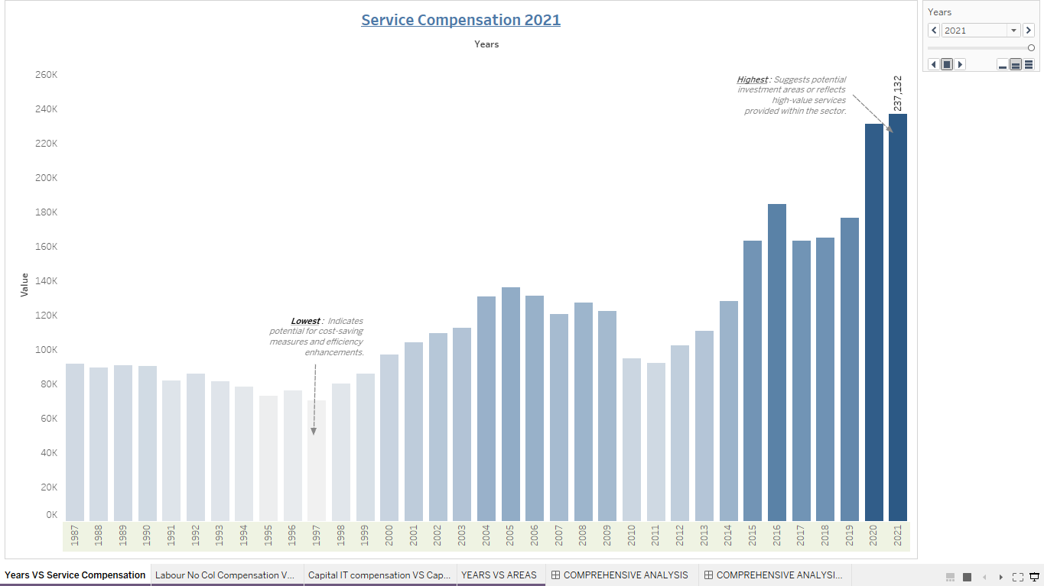
Were there any significant fluctuations or notable events that impacted service compensation from 1987 to 2021?
Our SHEET-1 shows the service compensation within the construction industry from 1987 to 2021, providing insights into the costs associated with purchased services over time, and employs a clustered column chart with animations showcasing the trends throughout the years.
To answer the question, there appear to be some notable fluctuations during the period. Service compensation experienced the most decline in the 1970’s, which could be attributed to the economic recession that occurred during that time. Additionally, there was a significant increase in service compensation at 2021, mostly due to the change in economic cycles, regulatory changes, and industry-specific demand shifts, such as major infrastructure projects or technological advancements.
Notes:
Our sheet-1 or our first question is “Were there any significant fluctuations or notable events that impacted service compensation from 1987 to 2021?”
Basically, we have constructed a clustered column chart, with varying contrast colors and employed animations as well which showcases each years growth from 1987 to 2021.
And we can notice that the lowest experienced when it comes to service compensation is during 1970’s which can be due to the start of economic recession during that time.
And we can also notice the highest service compensation in 2021, which can be due to several factors like change in economic cycles, or major infrastructure change and advancements.

Slide 7
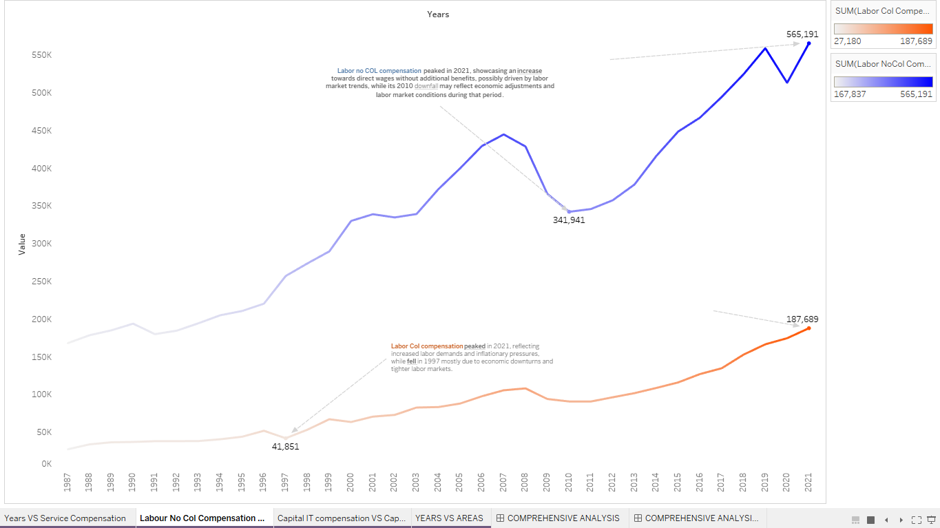
How did the trends in labor compensation with and without compensation differ over time?
Compares the trends in labor compensation with and without compensation, highlighting the differences between paid labor and unpaid or self-employed labor inputs in the construction industry.
Based on the line graph, labor col compensation (with compensation) generally exhibits a steadier upward trend compared to labor no compensation. Labor no compensation appears to be more volatile, with sharper fluctuations over time. This difference suggests that the compensation component of labor col compensation provides a stabilizing effect, while labor no compensation, which includes self-employed and unpaid workers, is more susceptible to economic fluctuations and changes in demand for construction services.
Notes:
For our second sheet, we have constructed a line graph for two factors, with legends highlighting the difference in colors between labor col (COST OF LIVING) compensation and labor no col compensation being blue in color.
And we have answered the question, “how did the trends in labor compensation and labor no col compensation differ over time.?’
We have done a small comparison between both of these key economic indicators to highlight the distinction.
The main reason why we have chosen these two factors is that comparing and relating labor compensation with and without cost of living (COL) adjustments is vital for understanding the true impact of COL on compensation structures.
It allows for accurate budgeting, ensures fairness in compensation practices, aids in strategic decision-making regarding benefits and talent attraction, assists in financial planning in diverse economic regions, provides insights into employee satisfaction and performance, and helps ensure compliance with regulatory requirements related to compensation.
PLEASE, READ THE DECLINATION, INCREASE, AND CAUSES OF THE DECLINE AND GROWTH - OF BOTH LINES FROM THE SLIDE.

Slide 8
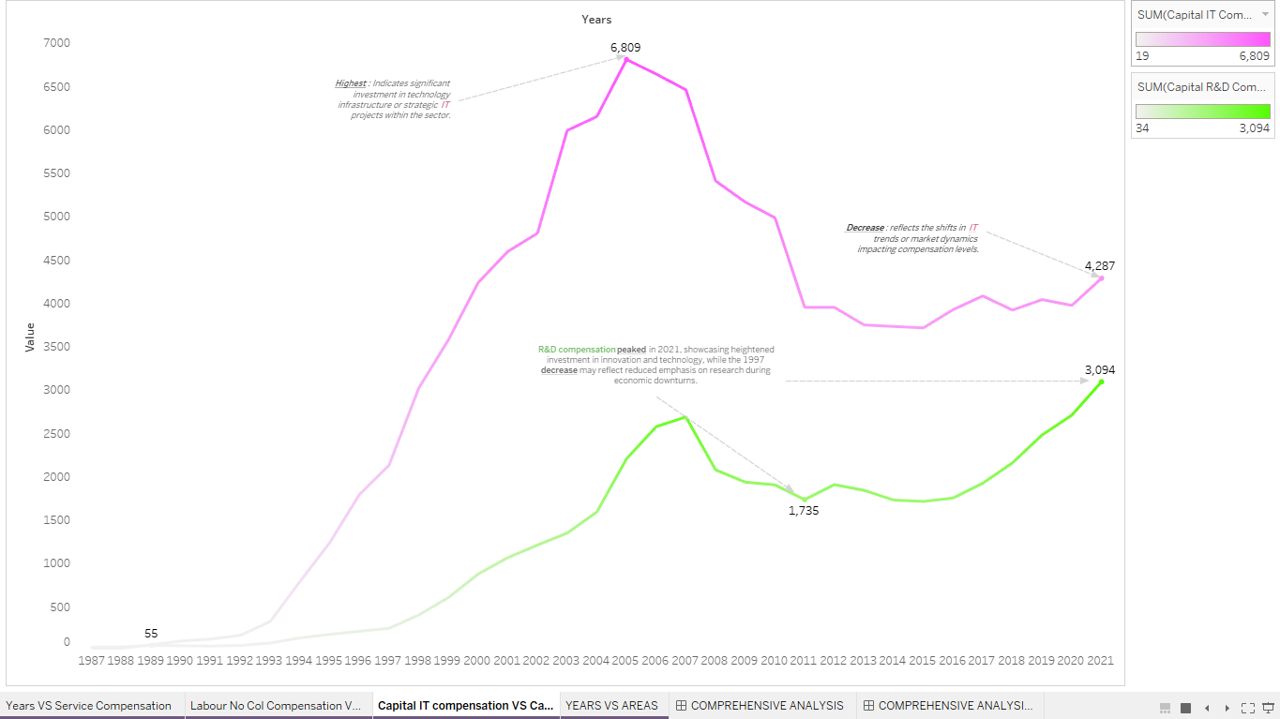
How have the construction industry's compensation levels for research and development (R&D) and information technology (IT) evolved over time?
Shows the compensation levels for research and development (R&D) and information technology (IT) personnel, reflecting the industry's investments in innovation and technology adoption.
Compensation levels for R&D and IT personnel in the construction industry have evolved significantly, reflecting increased emphasis on innovation, technological advancements, and the growing importance of digitalization and data analytics in construction projects, leading to higher compensation for skilled personnel in these areas.
Notes:
Similarly, for sheet 3, we have employed a line graph and constructed legends with differentiating colors between R&D and IT, being contrasts of green and pink.
And, the question is “how have the construction industry’s compensation levels for R&D and IT evolved over time?”
For that, first we need to understand that, just like labor compensation with and without benefits, R&D compensation and IT compensation are both related to the compensation paid to employees involved in research and development activities and information technology roles, within the construction industry.
These two areas are closely linked as technological advancements and innovations in construction often rely on research and development efforts, as well as the implementation and utilization of information technology systems and tools.
IT COMPENSATION: IT compensation reached its peak in 2005 at $6,085, likely due to increased demand for technology expertise, while the decrease to $4,287 in 2021 might reflect shifts in technology trends or market dynamics impacting compensation levels due to the implementation of AI.
R&D COMPENSATION: R&D compensation peaked in 2021 at $3,094, showcasing heightened investment in innovation and technology, while the 1997 low of $41,851 may reflect reduced emphasis on research during economic downturns.

Slide 9
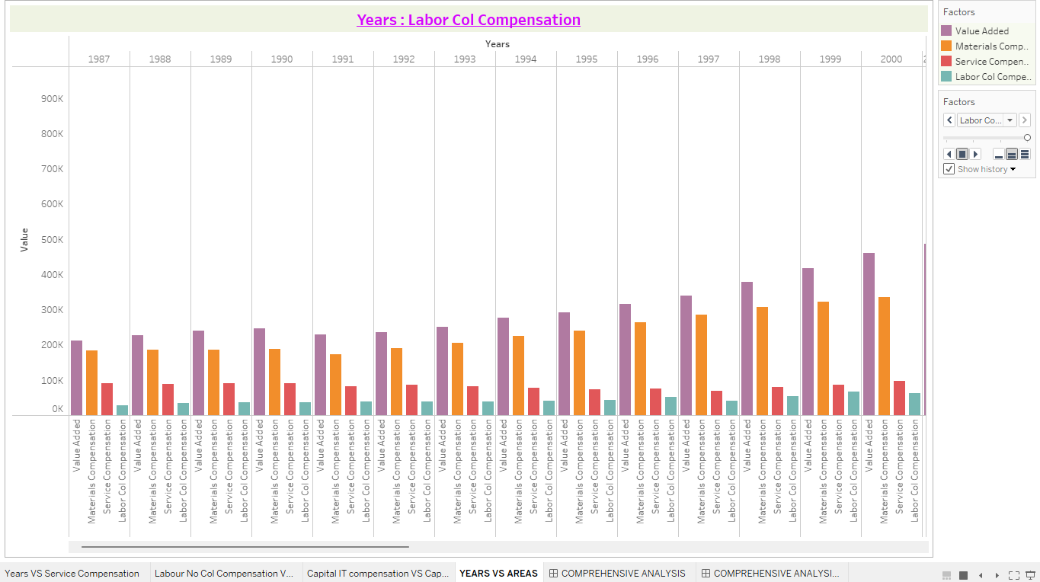
Can you identify any periods where one component experienced significant growth or decline compared to the others?
A clustered column chart, with an overview of key components contributing to the construction industry's output and costs, including value-added, material compensation, service compensation, and labor col compensation, allowing for a comprehensive analysis of their interrelationships and relative changes over time.
According to the column bar chart, material compensation, service compensation, value-added, and labor col compensation experienced a decline in 1987, which could be linked to the economic recession during that time and reduced demand for construction materials.
In contrast, material compensation, service compensation, value-added, and labor col compensation faced a steady increase during the year 2021, which can be due to increased demand, market growth, rising material costs, labor dynamics, and benefit enhancements drove significant increases in key economic indicators within the construction industry in 2021 compared to 1987.
Notes:
For sheet 4, we have constructed again a clustered column chart but the only difference is we have considered four factors which is value-added, material, service and labor col compensation.
The question here is, “ Identifying one component experiencing significant growth or decline compared to others?”
These components are interrelated within the construction industry. Value-added is derived from the combined inputs of materials, services, and labor, with the compensation for each representing the costs associated with those inputs. The construction industry creates value by transforming materials and services through labor into final products or structures.
According to the visualization, we can notice that all the components have faced an increase and decrease at the same time which lowest in 1987 and highest in 2021, again which can be due to rise in market growth, and significant technological advancements as we discussed previously.
Similarly, the construction industry components was the lowest in 1987 which can be due to the start of the economic recession leading to lower demand in construction supplies.

Slide 10
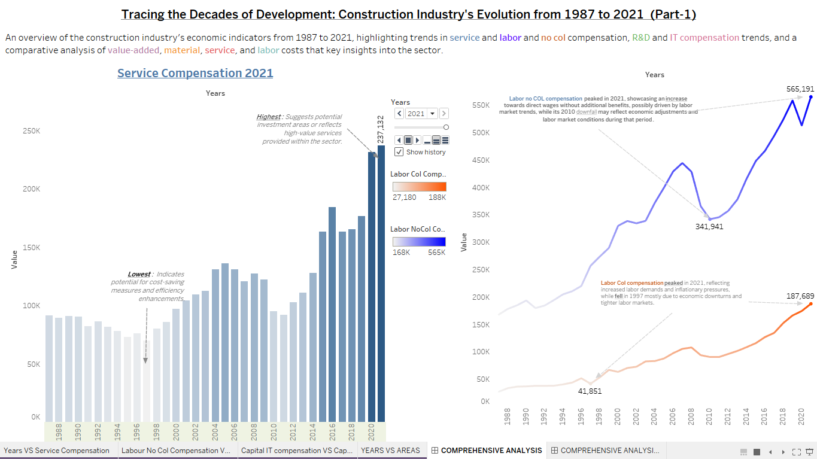
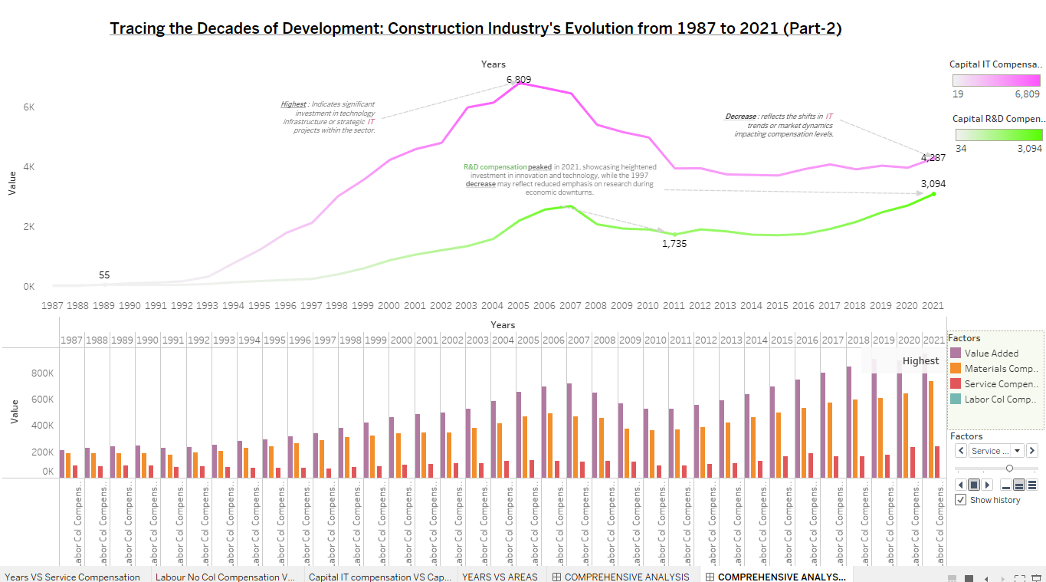
dashboard
This dashboard provides an in-depth analysis of key economic indicators within the construction industry from 1987 to 2021.
This dashboard explores trends in service compensation and compares labor compensation with and without benefits, focuses on the compensation levels for R&D and IT personnel, highlights investments in innovation and technology adoption, presents an overview of value-added, material compensation, service compensation, and labor col compensation, offering insights into the interrelationships and relative changes in these critical components over time.
Notes:
This dashboard provides us a description of a comprehensive analysis and an in-depth analysis of the key economic indicators for the construction industry from 1987 to 2021., and we have split the dashboard into 2 parts since we need the readers to have a clear view.
We have a consolidated view, in which, we can gain insights into the interrelations and changes in these critical components over time.
It offers interactive tools for analyzing service compensation, labor dynamics, material costs, and economic contributions over time. Users can explore productivity trends, cost optimization opportunities, market expansion strategies, labor management insights, innovation adoption possibilities, and risk mitigation measures.
The dashboard's user-friendly interface allows stakeholders to make data-driven decisions, plan strategies, and monitor industry performance effectively.

Slide 11
RECOMMENDATIONS
By performing this comprehensive analysis, we can say that;
Gain actionable insights into productivity, market growth, and labor market dynamics, empowering stakeholders to make informed decisions and strategies for the future of construction.
Enhance productivity through streamlined processes and technology adoption.
Manage costs by negotiating contracts and optimizing resource allocation.
Address labor dynamics with competitive benefits and workforce management.
Emphasize innovation, technology adoption, and sustainable practices.
Develop robust risk management strategies for market fluctuations.
Notes:
Which brings us to the next side where we will discuss about recommendations or uses of conducting a study based on the dataset and choosing the construction industry.
By performing such comprehensive analysis, we can gain proper insights into market growth, productivity, and labor market dynamics from these visualizations constructed in tableau – where the stakeholders can make decisions and incorporate strategies for the future.
Addressing the labor market with competitive benefits and workforce management is also vital.
Furthermore, productivity, managing costs, innovation, and risk management strategies all can be enhanced by understanding these fluctuations.

Slide 12
conclusion
This data-driven approach enables informed decision-making, strategic planning, and effective execution of initiatives to drive growth, competitiveness, and sustainability within the construction industry.
This comprehensive analysis conducted using Tableau and the KLEMS dataset has proven to be invaluable for the construction industry. The visualization of key economic indicators, labor trends, material costs, and economic contributions over the years has provided a deep understanding of the industry's dynamics and evolution.
By leveraging Tableau's powerful visualizations, stakeholders in the construction sector can gain actionable insights into productivity improvements, cost optimization strategies, market expansion opportunities, and labor management.
Notes:
In conclusion, by creating multiple visualizations, it enables us to make informed decision-making, strategic planning, and executing all the strategies effectively using data-driven approaches for increasing the growth in the construction industry.
Finally, by making use of Tableau's powerful visualizations, stakeholders can use the following data, in the construction sector, and can gain actionable insights into productivity improvements, cost optimization strategies, market expansion opportunities, and labor management.
ACKNOWLEDGEMENT
Finally, we would like to conclude our presentation by expressing our heartfelt gratitude to Dr. Dambar Uprety, our esteemed professor, for his invaluable guidance and unwavering support throughout this course. His mentorship, attention to detail, and willingness to address our queries have been instrumental in shaping our understanding and enhancing the quality of our work.
THANK YOU!

Slide 13

THANK YOU

